Slide 1
MedSynexa Pitch
India’s 10-second AI clinical copilot for safer, faster OPD decisions.

Slide 2
Introduction
MedSynexa is a real-time clinical reasoning layer designed for high-pressure Indian OPDs. It delivers actionable, evidence-backed suggestions in under 2 seconds to support doctors during the typical 10-second consultation. Built for trust, locality, and safety, it boosts accuracy and reduces diagnostic fatigue.

Slide 3
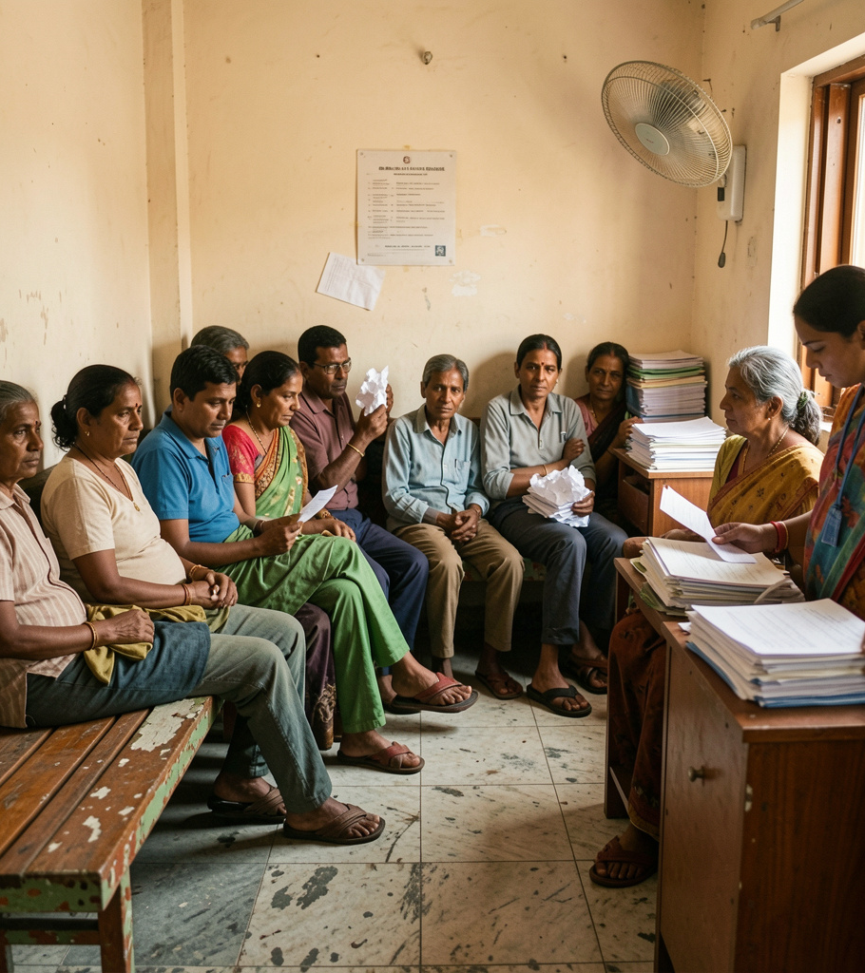
01
Topic 1

Slide 4
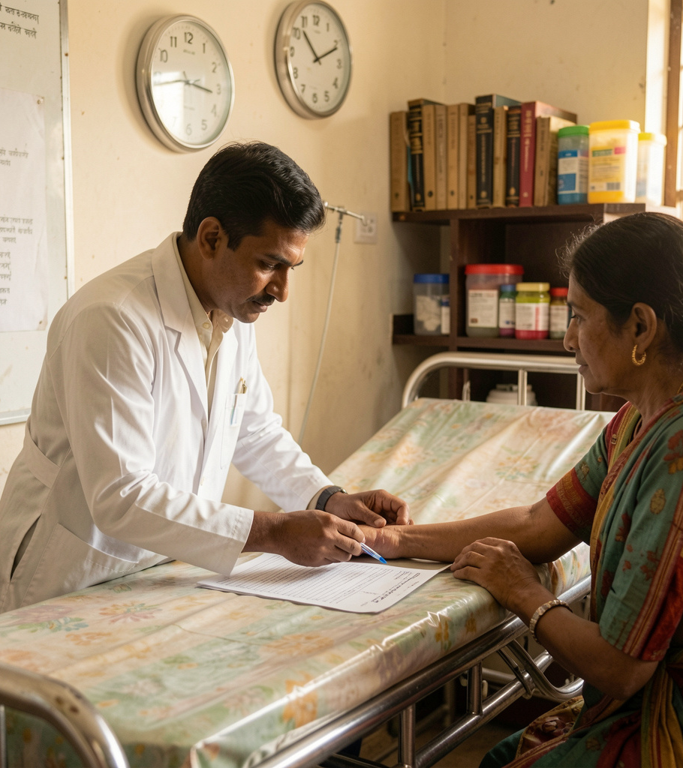
OPD Problem Snapshot
India’s outpatient clinics face extreme volumes: 60+ patients/day and under 2 minutes/case. This forces speed over precision, causing errors, overtreatment, and dissatisfied patients. The core gap: clinicians lack a quick, trusted point-of-care support tool to ensure consistent, evidence-based decisions.

Slide 5
Doctor Workflow Pain
Doctors are overwhelmed, fatigued, and often must rely on slow searches or memory. MedSynexa plugs into the workflow with a 3-step flow: quick shorthand input, instant RAG processing, and actionable outputs (diagnoses, tests, safe Rx) — all localized for India and optimized for sub-10s use.

Slide 6
Patient Outcomes Risk
Rushed OPD care leads to missed red flags, antibiotic overuse, and inconsistent treatment. Patients face delayed diagnoses and dissatisfaction.
MedSynexa reduces errors with evidence-backed prompts at the point of care, improving safety and patient trust within standard clinic timeframes.

Slide 7
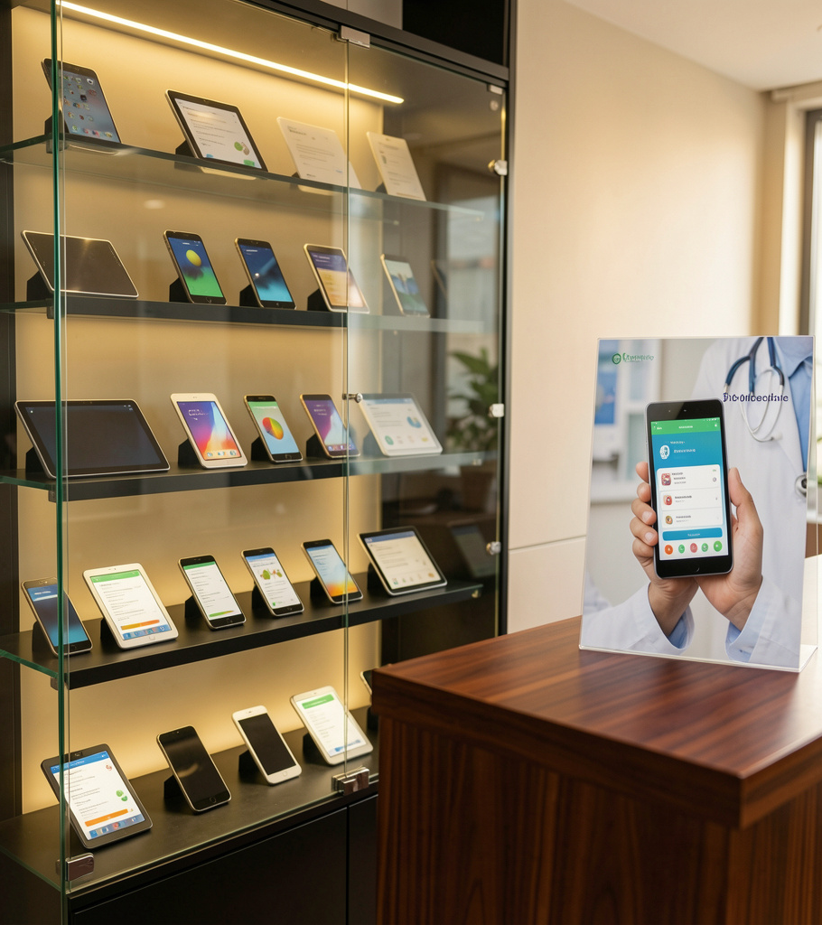
02
Topic 2

Slide 8
10s Clinical Copilot
MedSynexa ingests quick shorthand (10s), runs a context-aware RAG process, and returns actionable recommendations in under 2 seconds.
This workflow delivers likely diagnoses, immediate tests, and safe prescriptions—optimized for fast, high-volume Indian OPDs and offline use.

Slide 9

Market & Monetization
Targeting 1.3M active doctors and 100M+ annual OPD visits, revenue scales via subscriptions and enterprise licensing.
A freemium-to-professional model plus privacy-first pharma channels creates diversified income while prioritizing clinician trust and adoption.

Slide 10
Technical Safety & Moats
Built on India-specific guidelines, local formulary mapping, and PII-stripping at source. Hybrid cloud + local edge ensures low latency and offline resilience.
Defensive moats: India Evidence Graph, clinician validation loops, and product fit for sub-10s workflows.

Slide 11
Conclusions
MedSynexa empowers doctors to deliver faster, safer care with instant, localized clinical support.
By combining rapid inputs, rigorous safety, and scalable monetization, it transforms OPD workflows—improving outcomes, reducing burnout, and unlocking a large market opportunity.

Slide 12
Thanks!
Do you have any questions?
youremail@freepik.com
+91 620 421 838
yourwebsite.com
Please keep this slide for attribution

